Slide 1
Java Programming
Basics

Slide 2
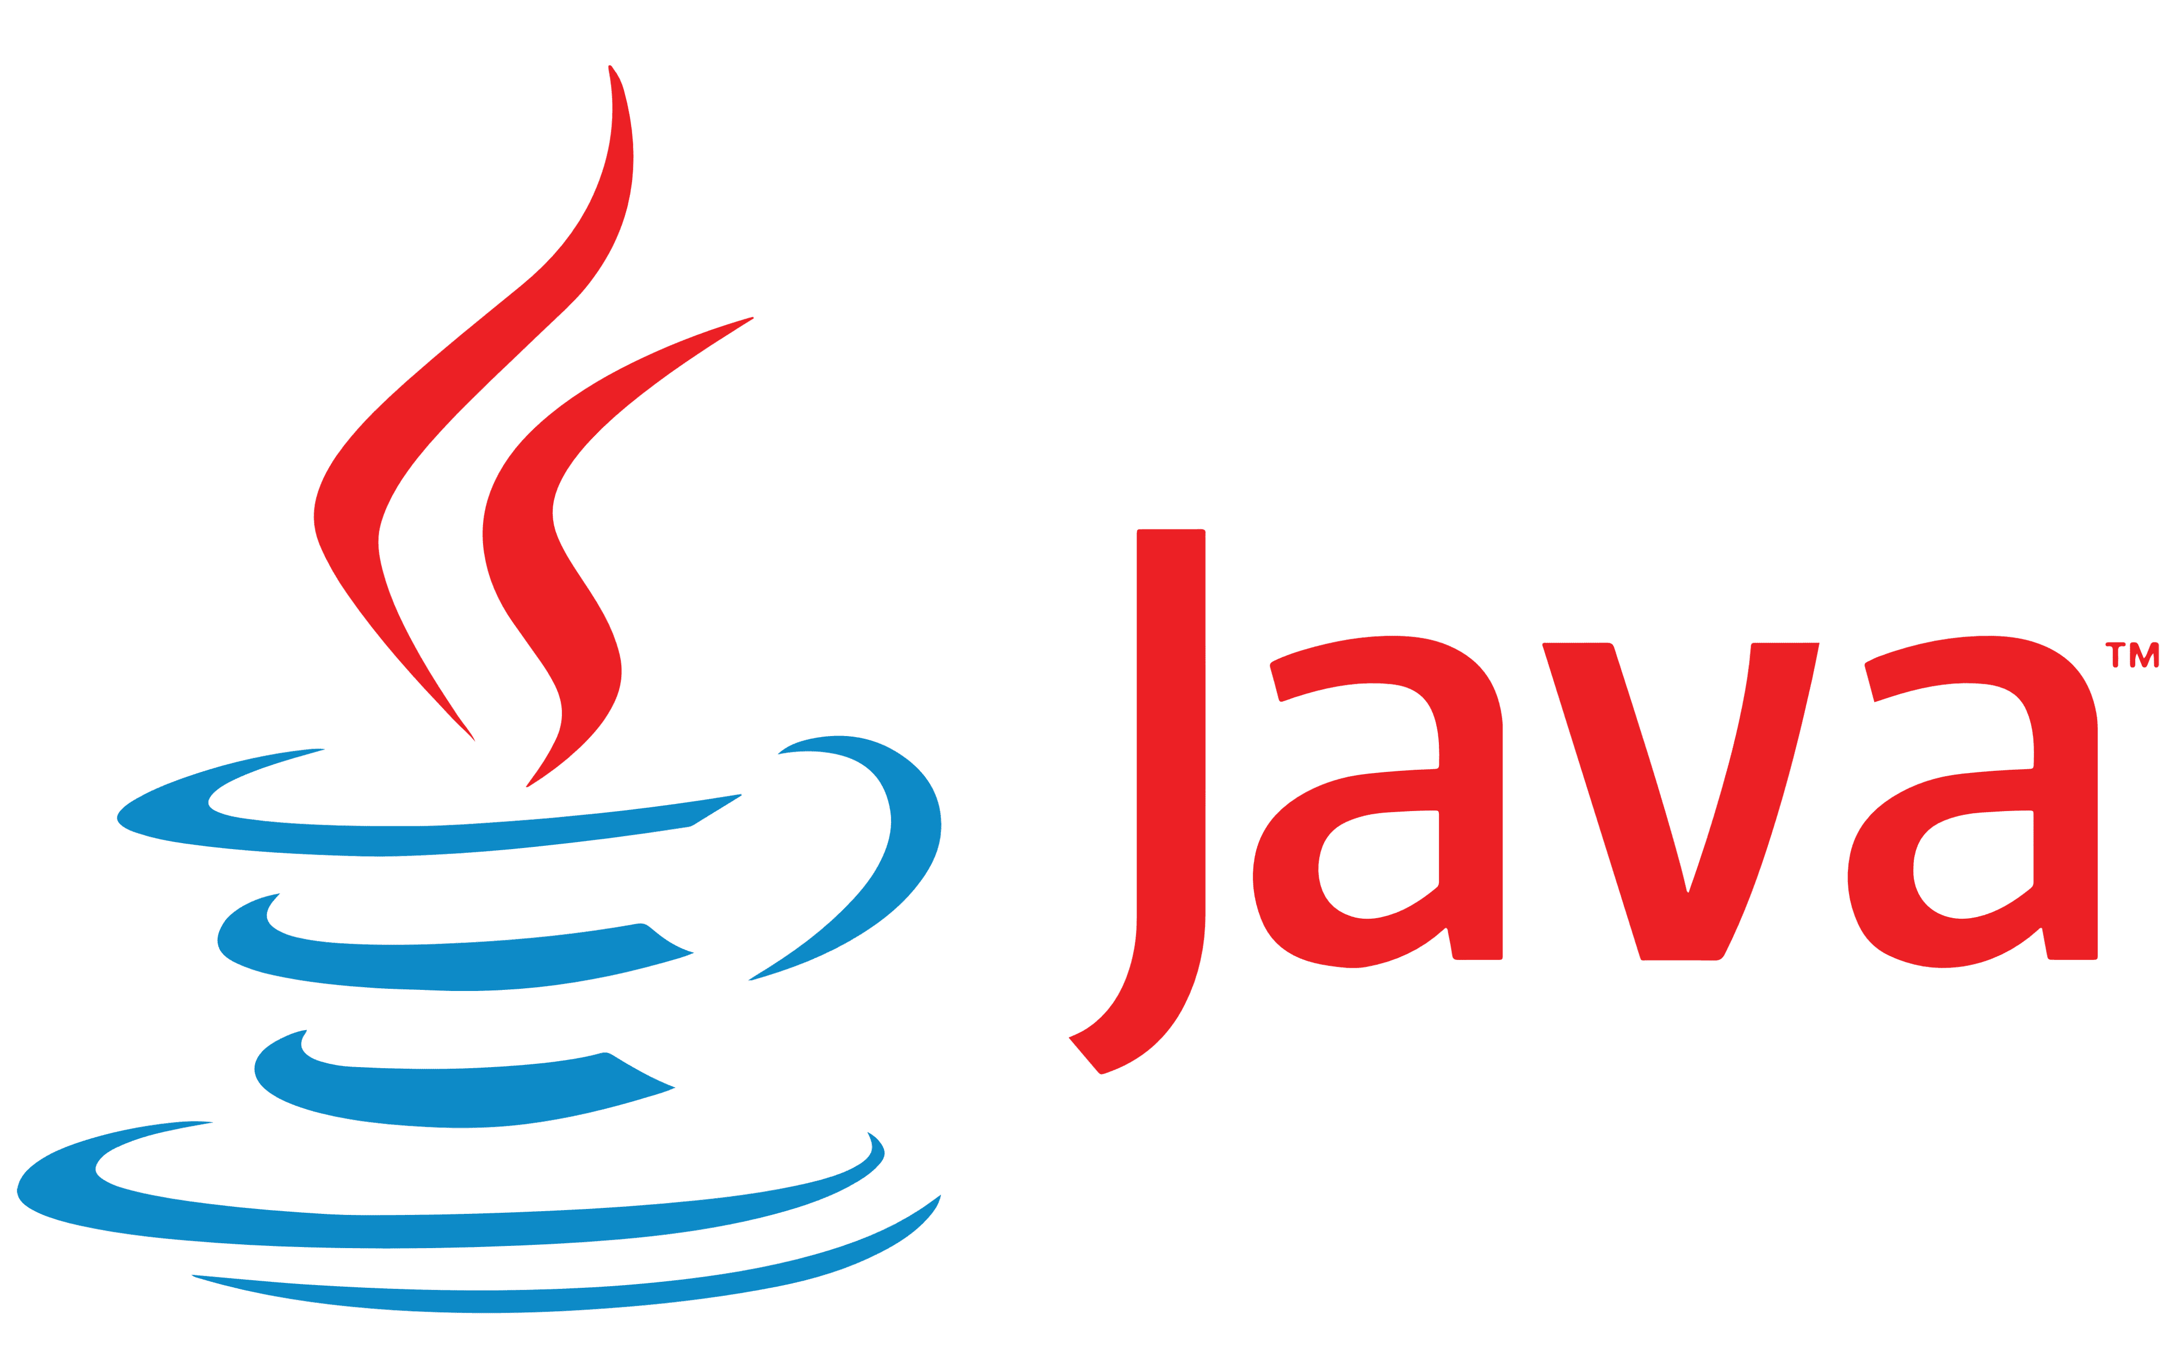
What is Java?
Java is a high-level, object-oriented programming language.
Popular for: Android apps, web applications, enterprise systems.
Fun Fact: Java’s motto is "Write Once, Run Anywhere".
Java was originally called Oak.

Slide 3
Why Learn Java in 2025?
✅ Still one of the most used languages in the world (used by millions of developers).
📱 Used to build Android apps, which dominate the mobile market.
🏢 Preferred by big companies for enterprise software (e.g., banks, insurance, e-commerce).
🌐 Runs on any platform – “Write Once, Run Anywhere” (Windows, Mac, Linux).
💼 High demand for Java developers in job markets across the globe.

Slide 4
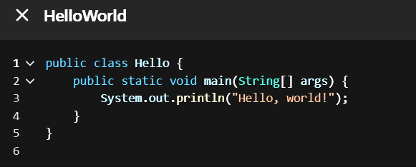
Java Syntax
Every coder starts from ‘Hello, World!’ — so keep practicing and stay curious.
Syntax = set of rules to write Java code.
Every Java Program must have a main() method
Example:
Real-life analogy: Like grammar in English – syntax ensures code is understood by the computer.

Slide 5
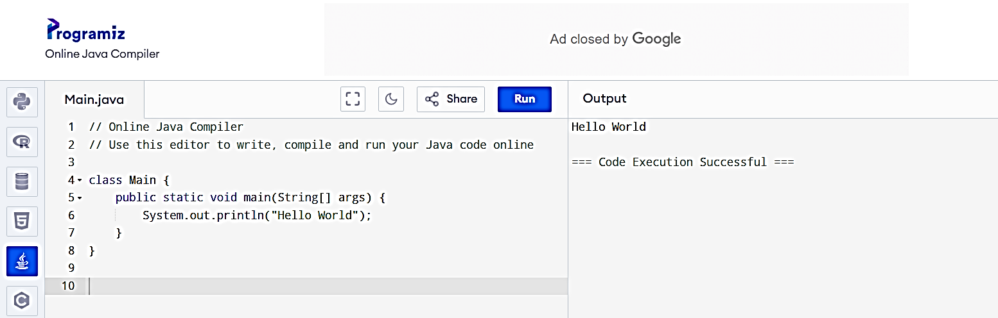
Where to Practice?
✅ Online IDE – no setup needed
👨‍🏫 Great for beginners and teachers
🧪 You can run and share Java code instantly
💡 Perfect for classroom-style learning

Slide 6
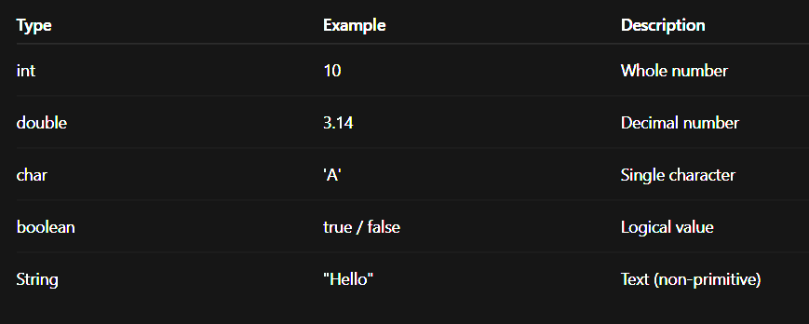
Data Types
Two types:
Primitive (int, float, char, boolean)
Non-primitive (String, Arrays, Objects)

Slide 7
Primitive Data Types (Simple Data) | Non-Primitive Data Types (Complex Data)
These are the basic building blocks in Java. | These are more advanced types created using classes.
They store simple values like numbers, letters, or true/false. | They store multiple values or complex information.
They do not have any functions or features. | They can do things using built-in methods/functions.
You can think of them like plain boxes holding values. | You can think of them like smart containers with tools inside.
int → for whole numbers (int age = 20;) | String → for text (String name = "Amit";)

Slide 8
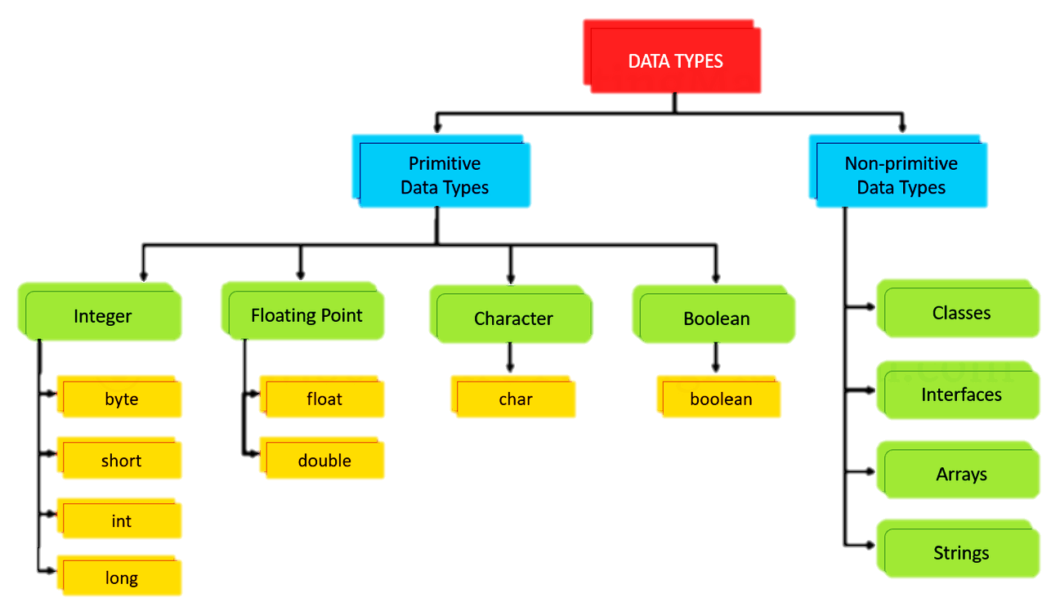

Slide 9
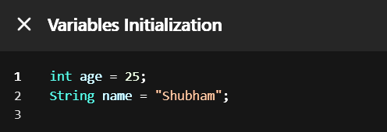
Variables
Variables store data.
Think of variables like boxes to store values.
Example:

Slide 10
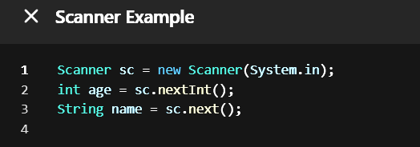
Scanner – Input from User
To take input from the user, we use Scanner.
Import first: import java.util.Scanner;

Slide 11
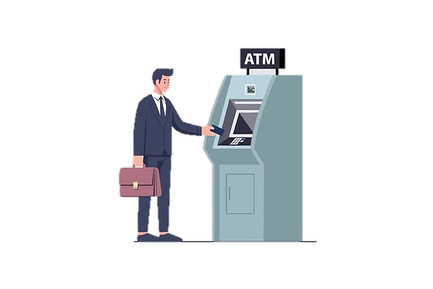
Real-Life Example of Input
Example: ATM machine
Asks for PIN (Input)
Shows Balance (Output)
You → Type PIN → System uses Scanner to read it.

Slide 12
Operators in Java
Arithmetic Operators
Relational (Comparison) Operators
Logical Operators
Assignment Operators
Unary Operators
Ternary Operator
Bitwise Operators (Advanced)

Slide 13
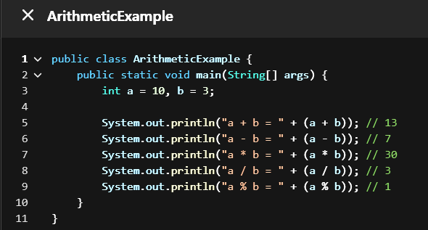
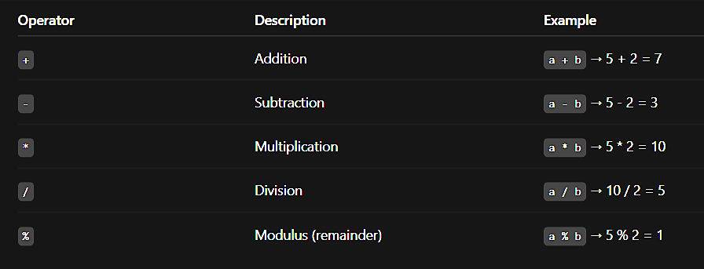
Arithmetic Operators

Slide 14
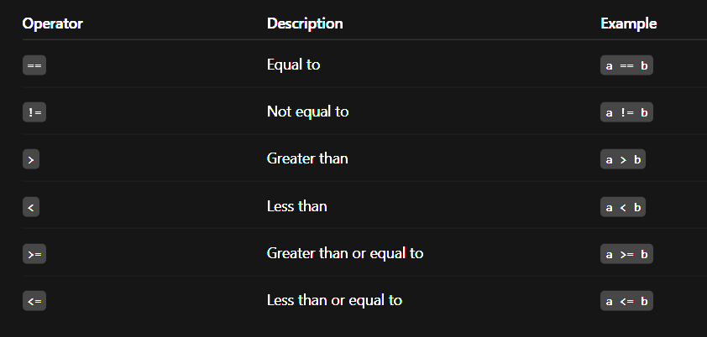
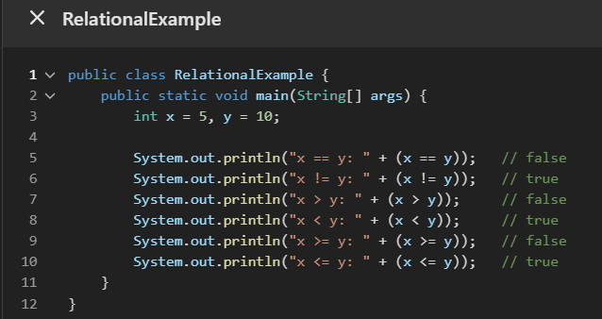
Relational (Comparison) Operators

Slide 15
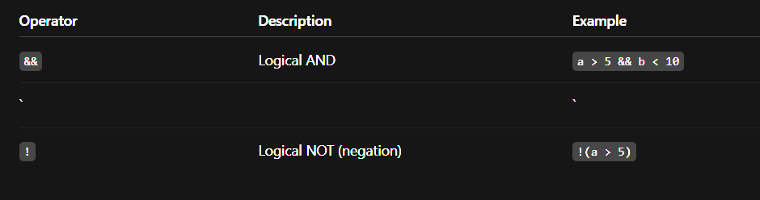
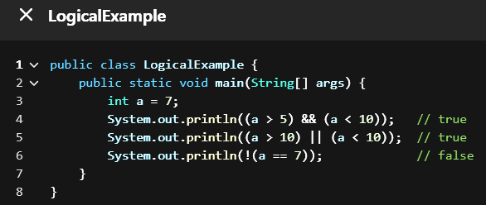
Logical Operators

Slide 16
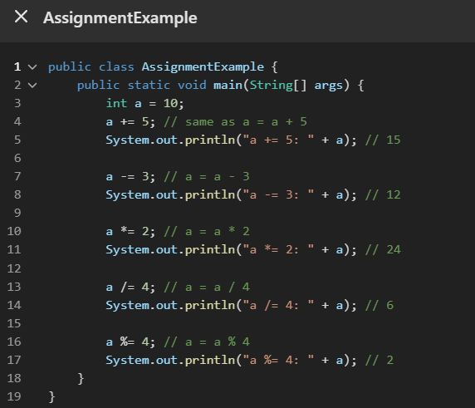
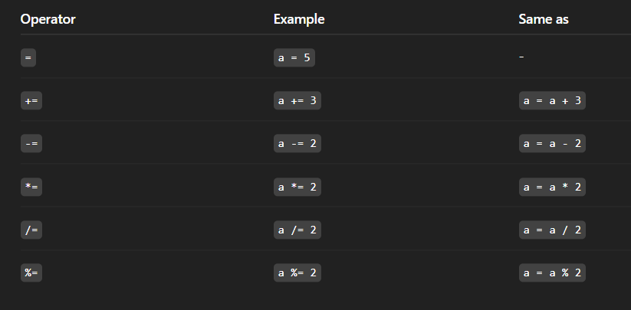
Assignment Operators

Slide 17

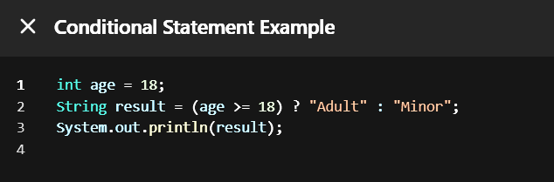
Ternary Operator
Explanation:
age >= 18 → this is the condition.
"Adult" → returned if the condition is true.
"Minor" → returned if the condition is false.

Slide 18
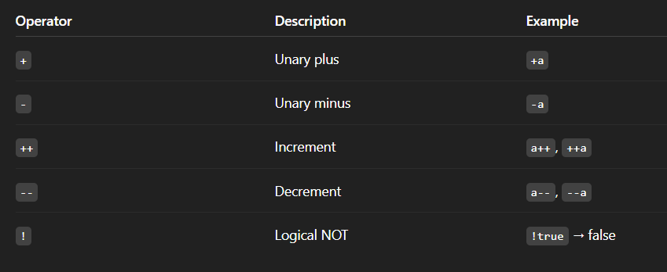
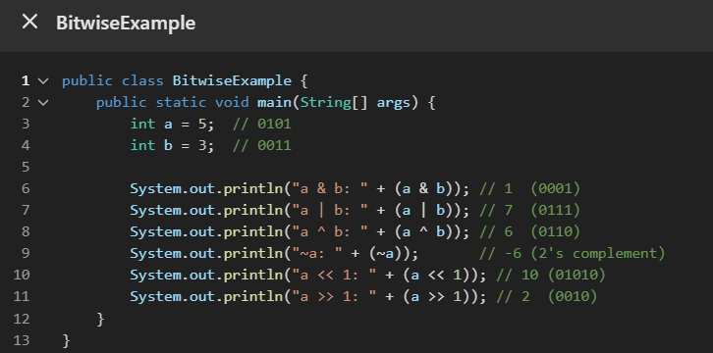
Unary Operators

Slide 20
Conditional Statements

Slide 21
Loops – Repeat Tasks

Slide 22
Real-Life Example of Loops

